Slide 1
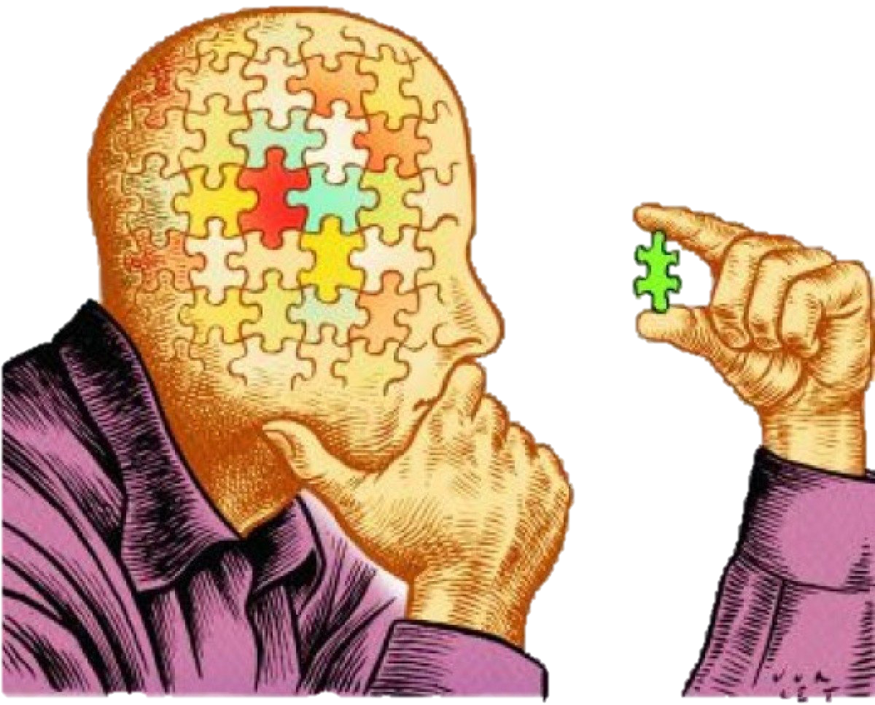
Argument reconstruction: the basics
Kareem Khalifa
Philosophy Department
Middlebury College

Slide 2
Overview
What is an argument?
Standard form
Soundness
4. Triangulation

Slide 3
1. What is An Argument?

Slide 4
2. StANDARD FORM

Slide 5
Sinnott-Armstrong & Fogelin (SAF), III.1
Since Chicago is north of Boston, and Boston is north of Charleston, Chicago is north of Charleston.
Chicago is north of Boston.
Boston is north of Charleston.
∴ Chicago is north of Charleston. (from 1,2)

Slide 6
SAF, III.5
Other airlines will carry more passengers, because United Airlines is on strike.
United Airlines is on strike.
∴ Other airlines will carry more passengers. (From 1)

Slide 7
3. SOUNDNESS
3.1. Validity
3.2. Truth

Slide 8
SAF, III.5
Other airlines will carry more passengers, because United Airlines is on strike.
United Airlines is on strike.
∴ Other airlines will carry more passengers. (From 1)

Slide 9
SAF, III.5, made valid
If United Airlines is on strike, then other airlines will carry more passengers.
United Airlines is on strike.
∴ Other airlines will carry more passengers. (From 1,2)

Slide 10
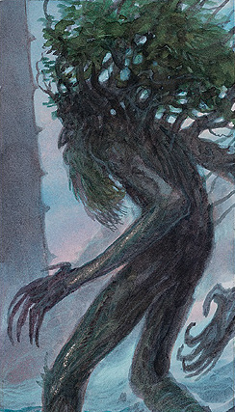
Exercise 1
No plants are sentient.
All morally considerable things are sentient.
∴ No plants are morally considerable.
VALID.

Slide 11
Exercise 2
All mathematical truths are knowable.
All mathematical truths are eternal.
∴ All that is knowable is eternal.
INVALID.
Suppose there is something knowable that is not a mathematical truth and that is not eternal, e.g., that I am experiencing a headache. Then it could still be the case that all mathematical truths are knowable and eternal, but that something knowable is not eternal.

Slide 12
Exercise 3
Most geniuses have been close to madness.
Blake was a genius.
∴ Blake was close to madness.
INVALID.
Suppose that Blake was one of the few geniuses that was well-adjusted. Then it could still be the case that most geniuses have been close to madness and Blake was a genius, but that Blake was nevertheless not close to madness.

Slide 13
Exercise 6
Some angels are fallen.
∴ Some angels are not fallen.
INVALID.
Suppose that all angels are fallen. Then it would still be the case that some angels are fallen, but nevertheless not be the case that some angels are not fallen.

Slide 14
Exercise 7
To know something is to be certain of it.
We cannot be certain of anything.
∴ We cannot know anything.
VALID.

Slide 15
3.2. Truth

Slide 16
4. TRIANGULATION
4.1. The process
4.2. Abortion example

Slide 17
4.1. The PROCESS
Step 1: Initial, valid argument.
Step 2: Weaknesses in premises.
Step 3: Revise premises in light of Step 2.
Step 4: Introduce the revised premises from Step 3.
Step 5: Revise argument so as to make it valid.

Slide 18
Step 1: Innocence Argument, 1st Pass
It is always morally wrong to kill an
innocent human being.
Abortion involves killing a human fetus.
A human fetus is a human being.
4) A human fetus is innocent.
5) ∴ Abortion is always morally wrong.

Slide 19
Step 2: What’s wrong with Premise (1)?
Some mentally ill people threaten the lives of others.
In such cases, mentally ill people are innocent.
It is not morally wrong to kill such people in self-defense.
So (1) is false: It is not always morally wrong to kill an innocent human being.
I call this an objection to the Innocence Argument

Slide 20
Steps 3&4: Innocence Argument, 2nd Pass
(1*) It is always morally wrong to kill an innocent human being, except in self- defense.
Abortion involves killing a human fetus.
A human fetus is a human being.
4) A human fetus is innocent.
5) ∴ Abortion is always morally wrong.

Slide 21
Step 5: Innocence Argument, 3rd Pass
(1*) It is always morally wrong to kill an innocent human being, except in self- defense.
Abortion involves killing a human fetus.
A human fetus is a human being.
4) A human fetus is innocent.
5) ∴ Abortion is always morally wrong.
5*) ∴ Abortion is always morally wrong, except in the case of self-defense.

Slide 22
Time Permitting…
More exercises

Slide 23
Further challenges to the Innocence Argument
(1*) It is always morally wrong to kill an innocent human being, except in self- defense.
Abortion involves killing a human fetus.
A human fetus is a human being.
4*) A human fetus is innocent.
5) ∴ Abortion is always morally wrong.
5*) ∴ Abortion is always morally wrong, except in the case of self-defense.

Slide 24
Exercise 10
The witnesses said that either one or two shots were fired at the victim.
Two bullets were found in the victim’s body.
∴ Two shots were fired at the victim.
INVALID. Suppose that one shot was fired at the victim, and another was the victim’s own bullet that struck him due to a misfire of his gun. Then it could still be the case that the witnesses said that either one or two shots were fired at the victim, two bullets were found in the victim’s body, but two shots were not fired at the victim.

Slide 25
Exercise 14
DNA contains the code of life.
Life is sacred.
∴ It is wrong to manipulate DNA.
INVALID. Suppose that it is proper to manipulate certain sacred things, as we do when we build or fix an altar. Then it could still be the case that DNA contains the code of life and that life is sacred, but that it is correct to manipulate DNA.
ALTERNATIVELY, suppose that, because DNA contains the code of life, manipulating it is the way to preserve the sacredness of life, e.g., by saving people from hereditary diseases.

